Slide 1
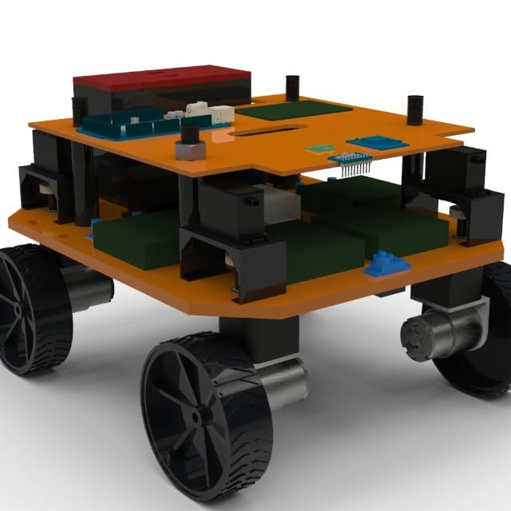
Intelligent Line Marking Bot (iLMBt)

Slide 2
ABSTRACT
In today’s age robots are used in various fields for various applications. The issue is marking field lines manually in a sports ground especially on gravel or sand grounds, which may lead to error and high time consumption. So we have designed an autonomous line marking bot, which can complete this process with ease. Our robot is aimed to provide accurate marking of any field within less time frame using sensors fusion algorithms to fuse various sensors to accurately localise the robot. Path planning algorithm is then used to navigate the robot to the end position. Simulation of the robot is done in Matlab - Simulink software using the existing libraries. After the simulation is successful the code is tested on an actual robot. The mechanical team will work on the design part. Proper suspensions and steering mechanisms will be made to overcome the uneven nature or the ground. Finally the code will be optimised and field tested till the desired accuracy is obtained.

Slide 3
Unique Features
All terrain design
4 wheel drive
4 wheel steering, 2 wheel steering, differential turning
Completely autonomous
Custom app for tracking bot and powder level
Manual override is also possible
Obstacle avoidance

Slide 4
Autonomous
Using GPS, IMU position and orientation is retrieved
Using lidar the obstacle position is obtained and the bot is manoeuvred or notified to user via app in case of complete obstruction.
The sensor values are passed through a filter to reduced the noise
The filtered values are used to calculate the kinematics of the bot.

Slide 5
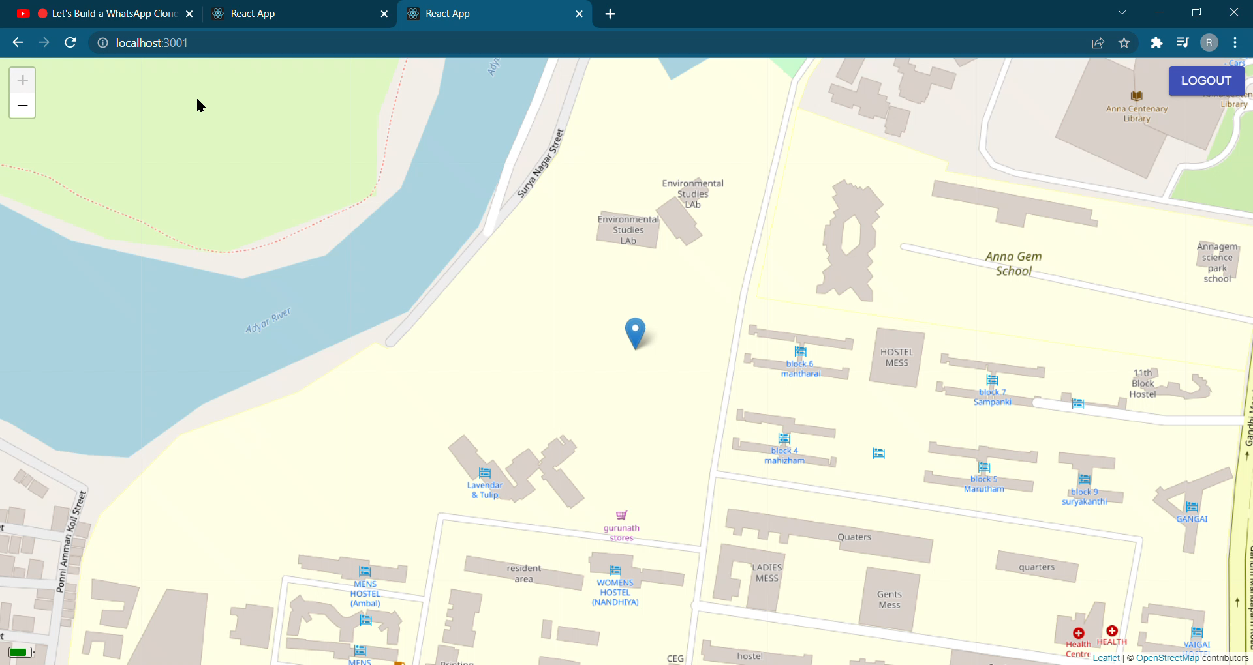
App features

Slide 6
Things to be done
Custom PCB followed by robust wiring
Calibration and tests
Endurance testing
Product oriented approach for the next iteration

Slide 7
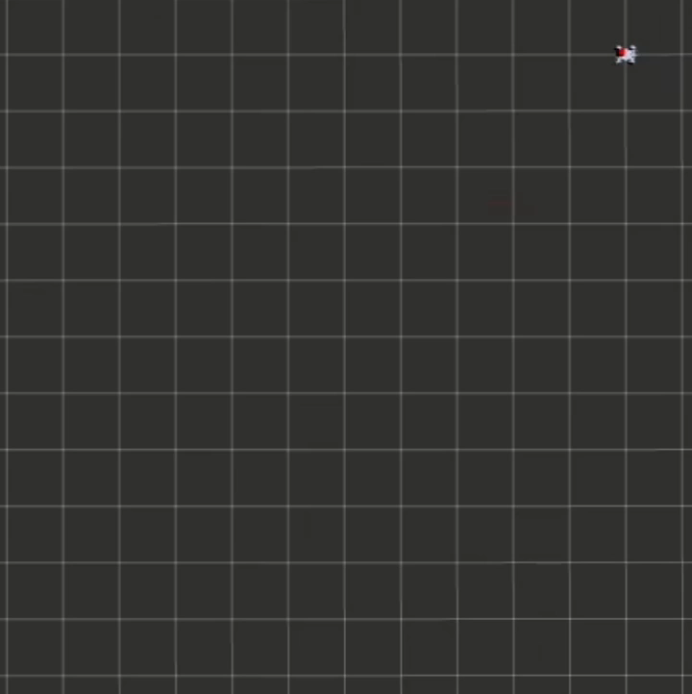
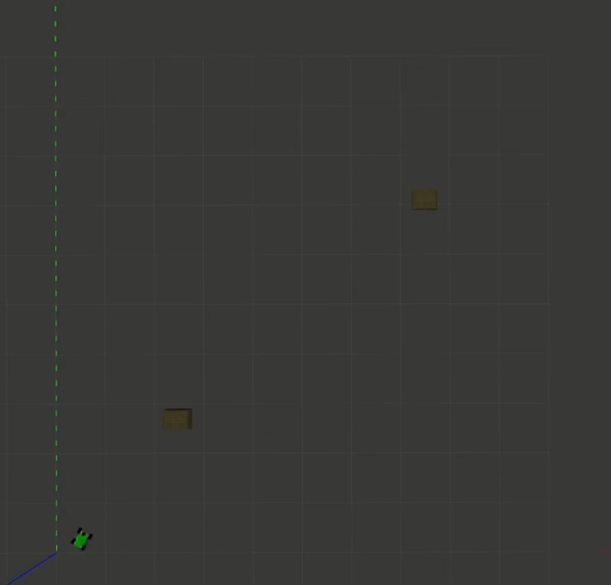
Simulation Videos
Autonomous line marking

Slide 8
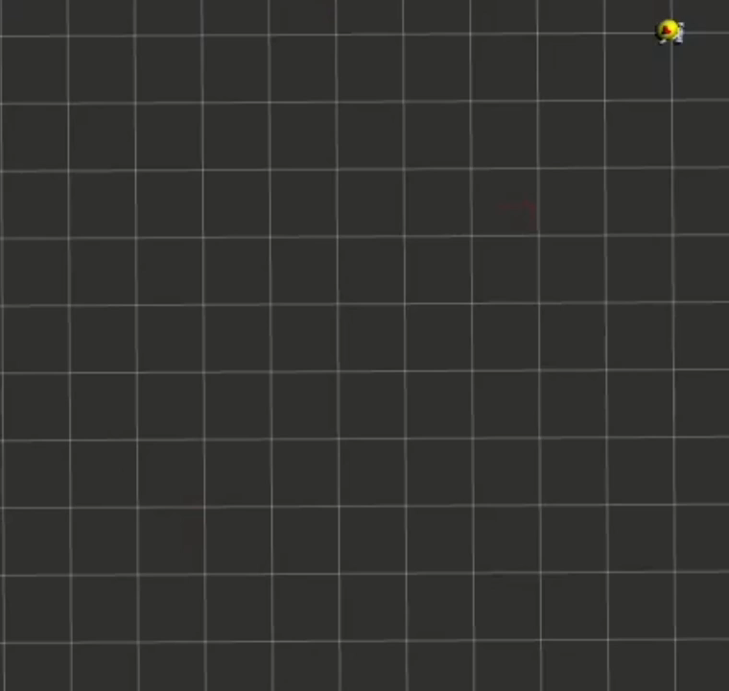
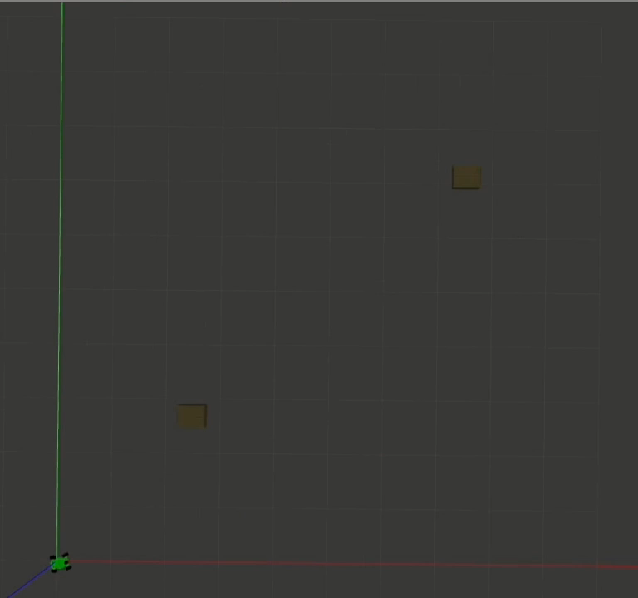
Simulation Videos
Obstacle avoidance

Slide 9
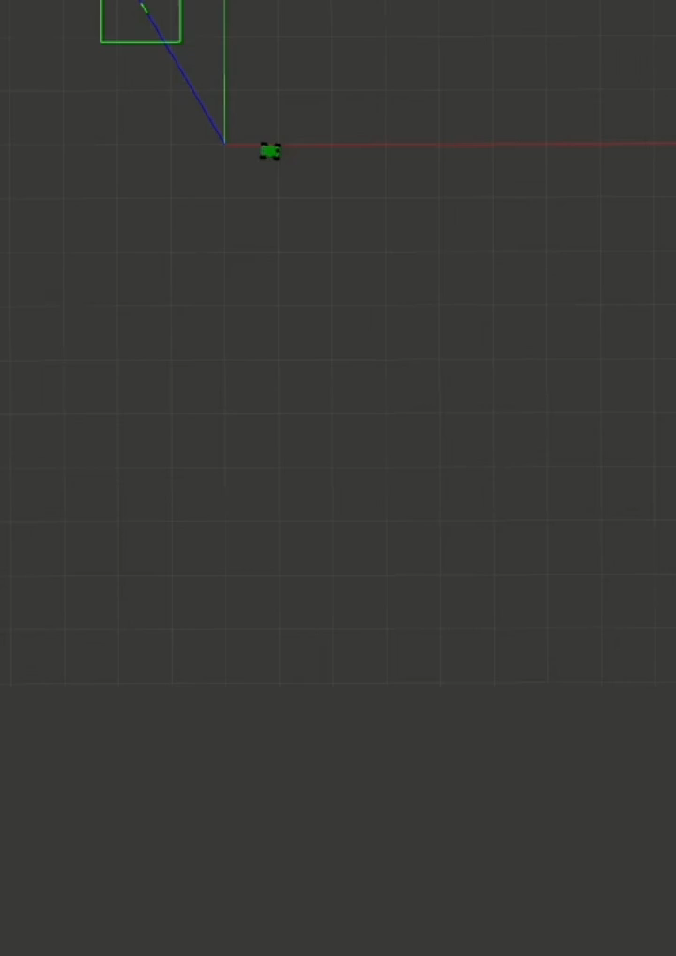
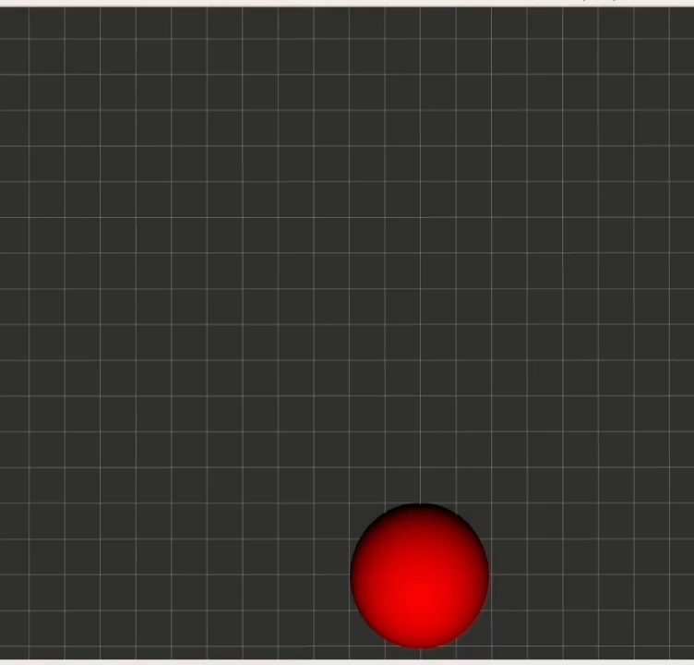
Simulation Videos
K logo!

Slide 10
Simulation Videos
K logo!

